Slide 1
Introduction to Management Accounting

Slide 2
Evolution of Management Accounting
Size and Complexity of Business operation
Application of Modern Technology
Introduction of Joint stock company
Separation of ownership and management
Threats of competitors
Need for meaningful and timely data (weekly/ monthly) for decision making
Growing need has changed the accounting form

Slide 3
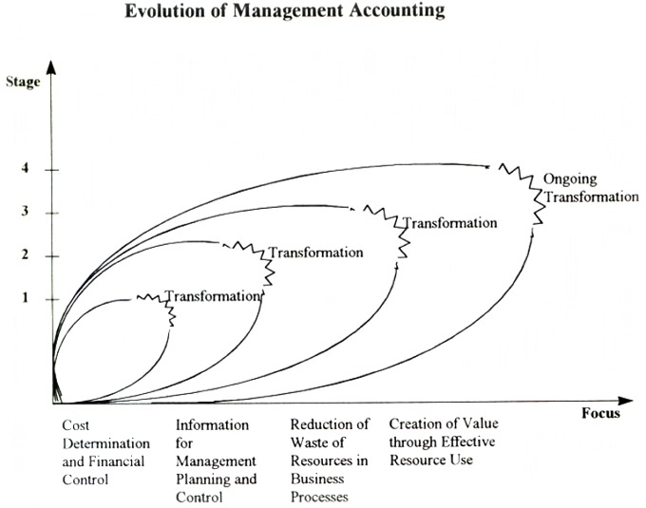
Continues….

Slide 4
Evolution of Management Accounting (Contd.)
Stage 1 - Prior to 1950, the focus was on cost determination and financial control, through the use of budgeting and cost accounting technologies;
Stage 2 - By 1965, the focus had shifted to the provision of information for management planning and control, through the use of such technologies as decision analysis and responsibility accounting;
Stage 3 - By 1985, attention was focused on the reduction of waste in resources used in business processes, through the use of process analysis and cost management technologies;
Stage 4 - By 1995, attention had shifted to the generation or creation of value through the effective use of resources, through the use of technologies which examine the drivers of customer value, shareholder value, and organizational innovation.

Slide 5
Definition
Management Accounting is concerned with providing information to managers inside an organization who direct and control the operations.
Management Accounting is the process of preparing management reports and accounts that provides accurate and timely financial and statistical information that required by managers of an organization to make day to day and short term decisions.

Slide 6
Definitions (contd.)
Management accounting generates monthly or weekly reports for an organization’s internal managers. These reports show the:
amounts of available cash on hand,
sales revenues generated,
amount of orders in hand,
state of the organization’s accounts payable and receivable,
Outstanding debts,
Raw materials,
Inventory,
Trend charts
Variance analysis, etc.

Slide 7
Objectives
To assist the management in promoting efficiency.
To prepare budgets covering all functions of a business.
To analyze monetary & non monetary transactions.
To compare the actual performance with plan & identifying variations and its causes.
To interpret the financial statements to formulate future policies.
To submit the results to the management at frequent intervals.
To provide a suitable organization for discharging responsibilities.
To arrange systematic allocation of responsibilities for the implementation of plans & budgets.

Slide 8
Scope of Management Accounting
The scope of management accounting is very wide. It includes within its fold all aspects of business operations. The following areas indicating scope of management accounting.
Financial accounting:
It provides historical information; It forms basis for future; securing full control & coordination of a business.
Cost accounting:
It provides various techniques of costing; It assists the management in the formulation of policies & the operations of the undertakings.

Slide 9
Scope of Management Accounting (contd.)
Budgetary control:
It helps to compare the actual performance with budgeted performance, measuring variations, finding out their causes & suggesting remedial measures.
Inventory control:
It is concerned with control over inventory from the time it is acquired till its final disposal.
Reporting:
It includes preparation of periodical income statements & other related reports like fund flow statements & cash flow statements. These statements helps to the management to evaluate the performance & decision making.

Slide 10
Financial, Cost, and Management Accounting
Financial Accounting focuses on gathering historical financial information to be used in preparing financial statements that meet the needs of investors, creditors, and other external users of financial information.
Management Accounting focuses on both historical and estimated data that management needs to conduct ongoing operations and do long-range planning.
Cost Accounting includes those parts of both financial and management accounting that collect and analyze cost information.

Slide 11
Comparison of Financial and Managerial Accounting
Notes:
There are seven key differences between managerial accounting and financial accounting:
❶ Users: Financial accounting reports are prepared for external parties, whereas managerial accounting reports are prepared for internal users.
❷ Emphasis on the future: Financial accounting summarizes past transactions. Managerial accounting has a strong future orientation.
❸ Relevance of data: Financial accounting data should be objective and verifiable. Managerial accountants focus on providing relevant data even if it is not completely objective and verifiable.
❹ Less emphasis on precision: Financial accounting focuses on precision when reporting to external parties. Managerial accounting aids decision makers by providing reasonable estimates more quickly, rather than waiting for precise data later.
❺ Segments of an organization: Financial accounting is concerned with reporting for a company as a whole. Managerial accounting focuses more on the segments of a company. Examples of segments include product lines, sales territories, divisions, departments, etc..
❻ Generally Accepted Accounting Principles (GAAP): Financial accounting conforms to GAAP. Managerial accounting is not bound by GAAP.
❼ Managerial accounting – not mandatory: Financial accounting is mandatory because various outside parties require periodic financial statements. Managerial accounting is not mandatory.

Slide 12
Cost Accounting Vs Management Accounting
Basis of Comparison | Cost Accounting | Management Accounting
Objectives | (i) Determination of costs (ii) Controlling of costs | (i) Planning Decisions (ii) Control Decisions
Activities | (i) Recording; (ii) Classifying; (iii) Allocating; (iv) Aggregating; (v) Reporting. | Analysis of costs
For whom prepared | Both internal and external interested groups | For internal management only
When prepared | Regularly at periodical intervals | As and when required
Principles followed | Generally accepted cost accounting principles | Principles relevant to a particular situation
Personnel involved | Top and middle level personnel | Top level management
Types of accounting system | Double-entry system | Any system that is useful

Slide 13
The Role of Management Accountant in the Organization
The role of management accountant in the organization is to support competitive decision making by collecting, processing, interpreting and communicating financial and statistical information that helps management to plan, control, and evaluate business processes and company strategy.

Slide 14
The Role of Management Accountant in the Organization (contd.)
Functions of Management Accountant:
Management control is the process of assuring that resources are obtained and used effectively and efficiently in the accomplishment of organization’s objectives.
Modification of Data: Modifies the available accounting data by re-arranging in such a manner that it becomes useful for management. For example – sales figures for different month may be classified, to know the total sales made during the period, product-wise, sales man wise and territory wise.
Helps in Planning and Forecasting: Provide necessary information & data to make short-term and long-term forecasts and planning for the future operations of the business. Accountant uses various techniques such as budgeting, standard costing, marginal costing, fund flow statement, trend ratio, etc.

Slide 15
The Role of Management Accountant in the Organization (contd.)
Financial Analyze and Interpretation: Accounting data is analyzed and interpreted meaningfully by Management Accountant for effective planning and decision making. Accounting data presents in a non-technical manner before top management along-with comments & suggestions to make them easily understood. Thus, analysis and interpretation of data are considered as backbone of management accounting.
Communication: Management Accountants make communication with different level of management. Top management needs concise information at relatively long intervals.

Slide 16
The Role of Management Accountant in the Organization (contd.)
Facilitate Managerial Control: Management Accountants set up the standards for various departments and individuals. The actual performance is recorded and variations are calculated. This enables the management to asses the performance of everyone in the organizations.
Use of Qualitative Information: Mere financial data and information are not sufficient for decision making process. That’s why management accountant frequently draws upon various sources other than accounting for qualitative information such as, engineering records, case studies, special surveys, productivity reports, etc.
Helps in Decision Making: Management Accountant furnishes accounting data and statistical information required for the decision making process.

Slide 17
The Role of Management Accountant in the Organization (contd.)
Management Accountant supplies analytical information regarding various alternatives and that the choice of management is made easy.
Coordinating: Co-ordination is the essence of managerial activity. The targets and performance of different departments are communicated to the management from time to time through providing different tools such as, budgeting, financial analysis and interpretation.
Reporting: Management Accountant prepares different types of reports as needed such as, income statements, fund flow statements, cash flow statements, trend ratio, etc. These statements helps to the management to evaluate the performance & decision making.

Slide 18
Organizational Structure
Decentralization is the delegation of decision-making authority throughout an organization.
Notes:
Decentralization is the delegation of decision-making authority throughout an organization by giving managers the authority to make decisions relating to their area of responsibility. An organization chart shows how responsibility is divided among managers and it shows formal lines of reporting and communication.

Slide 19
Line and Staff Relationships
Line positions are directly related to achievement of the basic objectives of an organization.
Example: Production supervisors in a manufacturing plant.
Staff positions support and assist line positions.
Example: Cost accountants in the manufacturing plant.
Notes:
An organization chart also shows line and staff positions in an organization. A person in a line position is directly involved in achieving the basic objectives of the organization. A person in a staff position is indirectly involved in achieving those basic objectives. Staff positions support line positions, but they do not have direct authority over line positions.

Slide 20
Process Management
A business process is a series of steps that are followed in order to carry out some task in a business.
Product Customer
R&D Design Manufacturing Marketing Distribution Service
Business functions making up the value chain
Notes:
Part I.
A business process is a series of steps that are followed in order to carry out some task in a business.
Part II.
A value chain consists of the major business functions that add value to a company’s products and services.

Slide 21
Tools & Techniques of Management Accounting
Financial Planning: Formulating financial policies and developing financial procedures to achieve the organization’s objectives. As for example - Taking decision about the sources of raising fund – Issue of share capital or raising loans.
Analysis of Financial Statement: Through analysis of financial statements, a forecast may be made about future earning, ability to pay debt, etc. It includes comparative financial statements, ratios, fund flow statement, trend analysis, etc.
Historical Cost Accounting: The statement of actual cost after they have been incurred is called Historical Accounting. Although these are of limited value, they are essential in order to operate a standard costing system.

Slide 22
Tools & Techniques of Management Accounting
Standard Costing: Standard Costing is an important tool of cost control, which is one of the main objectives of management accounting. The techniques of preparation of standard cost, their comparison with actual cost and their analyze of the differences. It is the most effective method available for controlling performances and costs.
Budgetary Control: The most widely used device for managerial control is budget. It is a quantitative expression of plan of action. Comparing actual performance with pre-determined targets.
Marginal Costing: This is a method of costing which is concerned with changes in cost resulting from changes in the volume of production. It is helpful for management to know about profitability of different lines of production.

Slide 23
Tools & Techniques of Management Accounting
Decision Accounting: Decisions are taken after studying the alternative data in terms of cost, prices and profit furnished by management accounting and exercising the best choice after considering other non-financial factors.
Ratio Accounting: Ratio accounting includes trend analysis, comparative financial statements, inter-period comparison, ratio analysis, fund flow statement, etc.
Control Accounting: It consists of techniques of standard cost, budgetary control, control reports and statements, internal audit report, etc.

Slide 24
Tools & Techniques of Management Accounting
Statistical Techniques: There is a large number of statistical and graphical techniques which are used in management accounting. Some common example are master chart, chart of sales and earnings, investment chart, etc.

Slide 25
Techniques in management accounting
Variance analysis
Ratios
statistics
Cost accounting
Management Accounting
operation research
Financial accounts
Mathematics
Budgetary control
Marginal costing
Cash flow statement
Trend percentages
FFS
Comparitive statement
Common size statements

